Slide 1
Norske obligasjonslån – mulighetenes marked
Shippingforum Østlandet
13 February 2013
Birgitte Karlsen

Slide 2
Introduction
2012 – all time high
Overview and legal framework
Focus on secured NHY – personal experience mainly from advising international issuers
Content of presentation:
Typical structure of secured NHY deal
Process and documentation requirements
Main difference from bank financing
Characteristics and main principles
Success factors

Slide 3
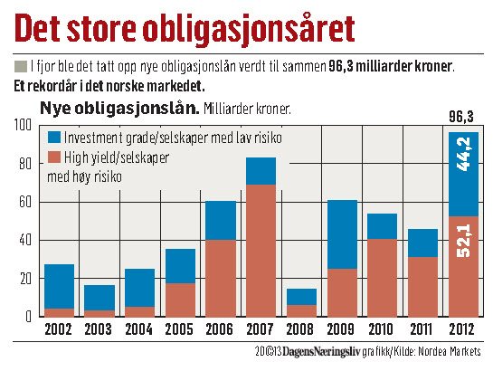
2012 – the year of the (Norwegian) bond loan
Restrictive banks and limited access to equity
Shipping, offshore and energy – large Norwegian investor base
Norwegian managers – unique position in the shipping and offshore market
US bonds vs Norwegian bonds – light document requirements
No need for finance rating

Slide 4
Norwegian high-yield bonds– legal framework
Bonds are "financial instruments" as set out in the Securities Trading Act sec. 2-2
Subject to prospectus requirements
General conduct of business rules
May be listed on Oslo Børs or Oslo ABM
Registration in a securities register (VPS)
Inside information provisions apply when listed
Bond loans are "omsetningsgjeldsbrev"
Negotiable securities
Bond loans are contractual obligations between the Lender and the Borrower
Norsk Tillitsmann (Trustee) represents the Lenders
Standard form of loan agreement by the Trustee

Slide 5
US high-yield bonds – key points
Registration with SEC
SEC requiers detailed information in a registration statement
Ongoing disclosure duties
Securities Act section as a starting point prohibits "deceptive practices in connection with the sale of securities"
in practice detailed disclosure provisions apply; but
not necessarily stricter than Norwegian law
US managers will usually require significant diligence of the borrower in case of a high yield bond issue
10b-5 letter
historically litigation more predominant in US markets
Notes:
Massesøksmål forekommer ofte i USA ifb utstedelse av lån/aksjer etc.

Slide 6
Norwegian and US high yield bonds
Norwegian market
US market
6-8 weeks "from start to finish"
Attractive investors in key industries
No specific disclosure requirements
Legal, financial or technical due diligence usually not required
Continuous assessment of disclosure
Standardised bond agreement and Trustee arrangement
Considered (for the most part) flexible and efficient
3 months +
Larger investor base
Generally requires
legal due diligence
financial due diligence
No market practice Trustee or bond agreement
SEC registration
Process to amend and restructure bonds
Notes:
Det er en myte at det norske markedet er uregulert og "fritt frem". Det er imidlertid klart at norske aktører krever lavere grad av undersøkelser enn det amerikanske – der avgis såkalte 10b-5 opinions, som i praksis krever full juridisk DD samt at det kreves auditors letters.

Slide 7
Norwegian high yield bonds – level of diligence
Borrower:
Investigations and information is governed by the bond loan agreement
general business practice rules of the Securities Trading Act applies
Managers and advisors:
Norw: "avledet undersøkelsesplikt": a duty to indentify, pursue and disclose any "red flags"
general business practice rules of the Securities Trading Act applies
Some borrowers pose a higher risk of default than others
assets under construction (vessels, mining, rigs)
additional disclosure and investigation may be necessary
Notes:
Uutstedelse" av nye obligasjonslån, refinansiering e.l andre transaksjoner (all "handel") er omfattet av forbud mot urimelige forretningsmetoder i vphl. § 3-9.
"Avledet undersøkelsesplikt" betyr at tilrettelegger må foreta nærmere undersøkelser der det er grunn til mistanke ("red flags"). Utgangspunkt; intet lovkrav om at tilrettelegger skal foreta uavhengige undersøkelser av utsteder. Har tilrettelegger oppfordring til å gjøre undersøkelser?

Slide 8
Norwegian High Yield
High Yield- "speculative grade risk" (below "BBB -" rating)
Senior Unsecured Corporate Bonds
general corporate purpose
Senior Secured "Corporate Bonds"
group financing of fleet
good for debt leverage
Senior Secured "Project Bonds"
pre and/or post delivery financing
good for bridge /start up financing

Slide 9
Senior Secured Corporate Bond
Parent Company (Issuer)
Bond Issue 200m
Bondholders
Loan Trustee
Floatel Superior
Floatel Reliance
Floatel Victory
Unit 1 Owner
Unit 2 Owner
Unit 3 Owner
Bank Facility USD 150m
Security:
1st pri.
Bank Facility USD 130m
Security:
1st pri.
Bank Facility USD 200m
Security:
1st pri.
Security:
2st pri.
Security:
2st pri.
Security:
2st pri.
Syndicate 1
Syndicate 2
Syndicate 3
Notes:
TROR VI HER KAN DROPPE 2ND PRI GARANTIEN FOR Å RENDYKRE POENGENE.

Slide 10
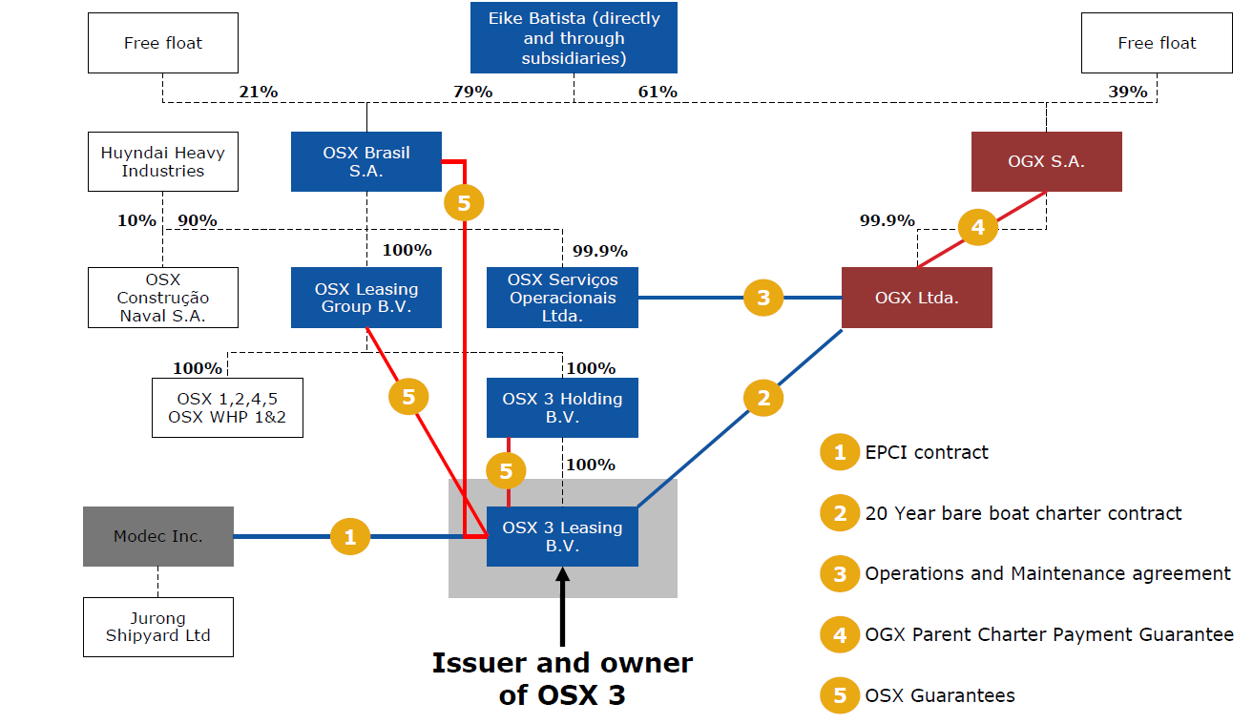
Senior Secured Project Bond

Slide 11
Process and documentation requirements
 | Week 1 |  |  |  |  |  |  | Week 2 |  |  |  |  |  |  | Week 3 |  |  |  |  |  |  | Week 4 |  |  |  |  |  |  | Week 5 |  |  |  |  |  |  | Week 6 |  |  |  |  |  |  | Week 7 |  |  |  |  |  |  | Interim Period |  |  |  |  |  |  | Week X |  |  |  |  |  |  | Week XX
Main Milestones
Kickoff
Pre-sounding
Launch
Settlement
Drawdown
Project Documents
Mandate Agreement
Termsheet
Offering Circular
Company Presentation
Application Form (Big Boy Letter?)
Bond Loan Agreement
Security Documents / CPs pre-settlement

Slide 12
Main differences from bank financing
Legal structure, security and covenant package not very different
Negotiation process different – creating package balancing terms against price
Role of NT different from a bank agent
Unknown lenders
Experience and motivation of lenders - no "relationship lending"
Don't rely on waivers and consents
Prepayment only against "make whole" payments
Commercial terms and costs may differ a lot, some positive and some negative for issuers.

Slide 13
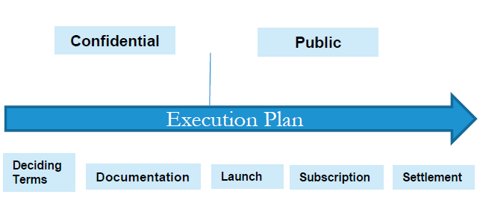
Characteristics and essential principles
Timing always a challenge
placing “ window“ unpredictable
allow time for house keeping
third party consents
simultaneous closing of parallel transactions
active involvement by bondholders may cause delay
Timing of CP requirements
when to be delivered?
objective criteria essential
use of third party experts
issuers need for flexibility …

Slide 14
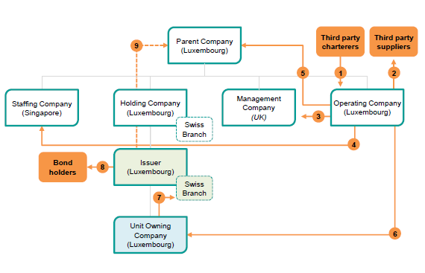
Characteristics and essential principles cont.
Company structure often complicated
tax driven
to ringfence other group investments and exposure
to enable future investments
challenge to see flow of funds fitting financial model
PE funds with interest in equity, 1st and 2nd priority bonds/loans
Use of tap-in structures to cover future funding needed as alternative to "early funding"?

Slide 15
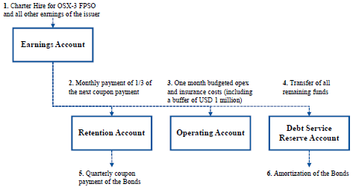
Characteristics and essential principles cont.
Flow of funds / waterfall / account structure
from client to bondholders through many layers – very stringent
financial model will be scrutinized by investors
cash sweep mechanisms to account for OPEX
No leakage out of "borrowing group“
what constitute unpermitted leakage
need for flexibility inside borrowing group
subordination of all intra group loans to issuer and guarantors

Slide 16
Characteristics and essential principles cont.
Corporate bonds relying mainly on financial covenants
Project bonds attempting locked box system with restrictions on new investments, debt, financial support and security
Carve outs needed to maintain operational flexibility
understanding of "normal course of business"
required upgrading/investments
amendments or termination of “Project Documents”
minimum requirements for new employment contracts

Slide 17
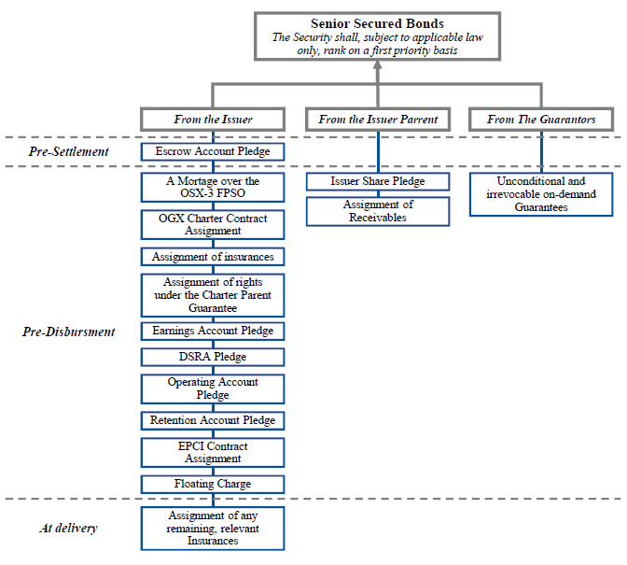
Characteristics and essential principles cont.
Security package
catch all to enable step-in
limitations by law and/or contract (DD required)
adjustment to contract structure
Quite Enjoyment issues
assignment of earnings
Intercreditor arrangements
to be attached to the TS
subordination in security or also in debt?
capping of amounts
length of “standstill period”
obligation to optimize recovery
restrictions on amending terms of 1st or 2nd loan

Slide 18
Characteristics and essential principles cont.
Shareholders
Shipyard
Bondholders
Banks
Related Party Transactions
arms lengths terms
existing to be disclosed / future to be restricted
Mandatory Prepayment
when (not too narrow)?
not satisfying CP's within long stop date
partial repayment
calculation of premium
remedy periods / equity cure rights

Slide 19
Success factors
Manage expectations during the process - timing and achievable terms
100% commitment from management and board to the process - avoid on/off
Take advantage of lessons learned on previous deals
Involve NT early in the process
Experienced team on both sides essential

Slide 20
Contact details
OSLO
Tel +47 22 82 75 00
Fax +47 22 82 75 01 oslo@wr.no
BERGEN
Tel +47 55 21 52 00
Fax +47 55 21 52 01
bergen@wr.no
LONDON
Tel +44 20 7236 4598 Fax +44 20 7236 4599 london@wr.no
SINGAPORE
Tel +65 6438 4498
Fax +65 6438 4496
singapore@wr.no
KOBE
Tel +81 78 272 1777 Fax +81 78 272 1788 kobe@wr.no
SHANGHAI Tel +86 21 6339 0101 Fax +86 21 6339 0606 shanghai@wr.no
www.wr.no

