Slide 1
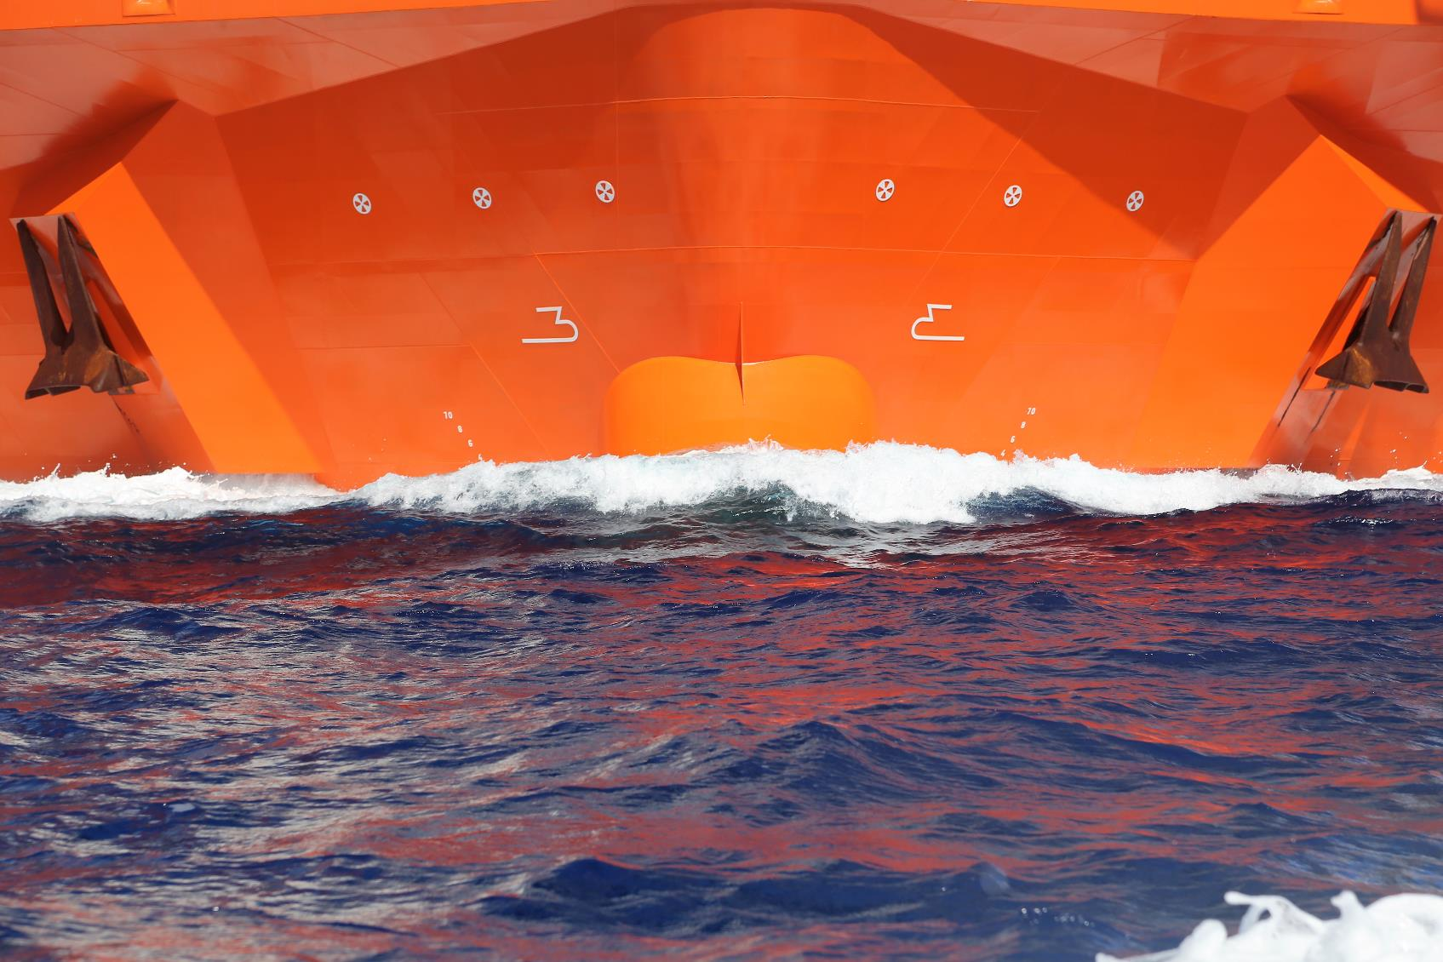
Offshore Wind; a challenging game of lifting Presentation to “Shippingforum”
Fred. Olsen Ocean AS
Ketil Arvesen, Vice President 31st October 2017
Notes:
Welcome
Practical information.

Slide 2
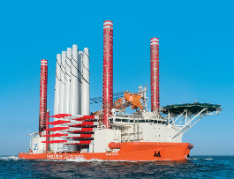
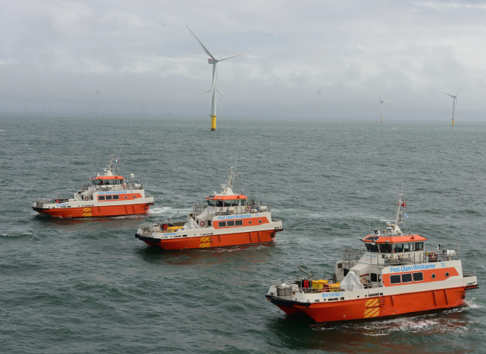
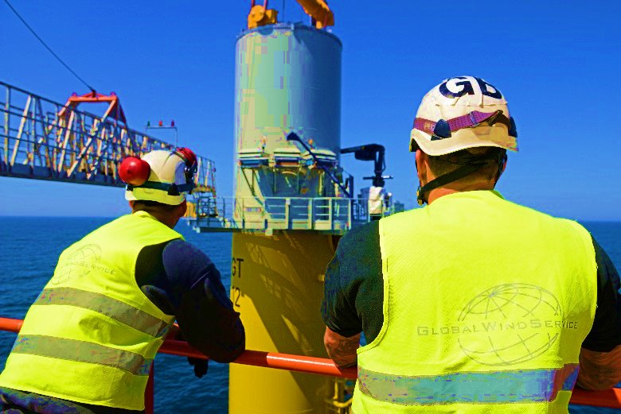
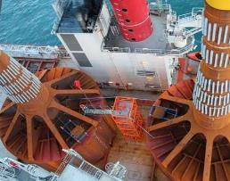
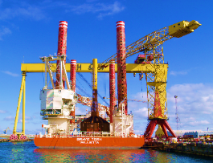
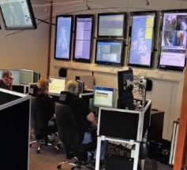
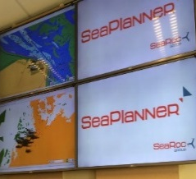
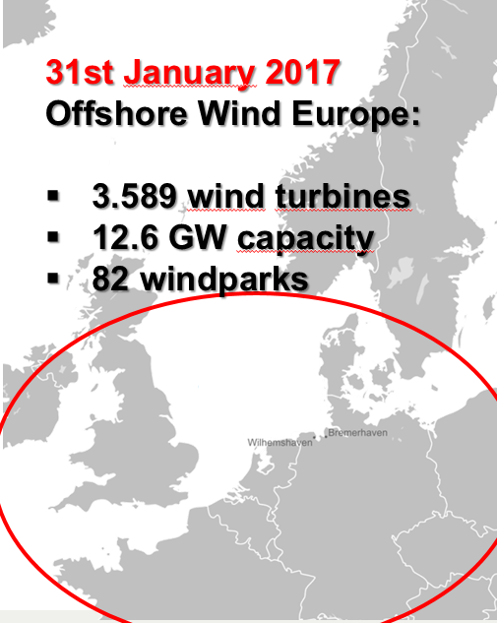
Fred. Olsen related companies in Offshore Wind
Offshore Wind
Fred. Olsen Windcarrier NO
Fred. Olsen Windcarrier DK
Global Wind Service
Universal Foundation
Harland & Wolff
Jack-up Installation
Vessels
2 world-class, custom
built offshore wind
jack-up installation
vessels
WTG installation
Foundation installation
Major Projects
O&M
Design & engineering
Crew transfer
vessels
7 crew transfer
vessels operating in
all major offshore wind
markets
Crew and equipment
transfer
Generator refuelling
63,000+ transfers
Technical
manpower
8 business units:
DK, UK, DE, NL, PL,
RP TR and SA
700 personnel
On and offshore
Installation
Service & maintenance
Main component
exchange
HV
WTG foundations
The Carbon Trust’s
Selected Foundation
Depth range 20-55m
3-8MW + WTGs
Quick installing
Weight saving
Silent installation
No grouting
Reduced scour
Renewables hub
Renewables hub
Assembly
Logistics
Foundations
Substations
Vessel repair and
maintenance
Natural Power
SeaRoc
ZephiR
Leading
Renewable Energy
Consultancy
Independent
consultancy
and services provider
95 GW of project
experience
32 MtCO2 abated
330+ renewable
experts
32 countries of
project experience
Leading Offshore
Products &
Consultancy
SeaPlanner
preferred offshore
management
system software
Used for one third of
installed wind
turbines in Europe
Marine and Offshore
Health and Safety
consultancy
World Leading
Wind Lidar
System
1000+ deployments globally, 10m+ operational hours
Cost effective
alternative to
traditional Met. Masts
Improves performance
of all WTG types
Reducing Cost of
Wind Energy
through lifecycle
Abt. 1.400 employees
(incl. NP, SeaRoc, Zephir)

Slide 3
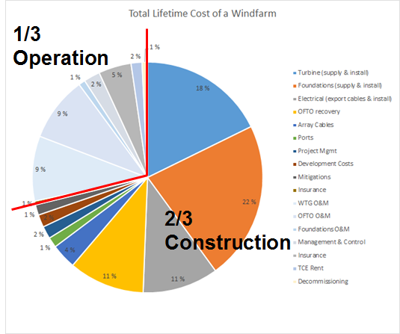
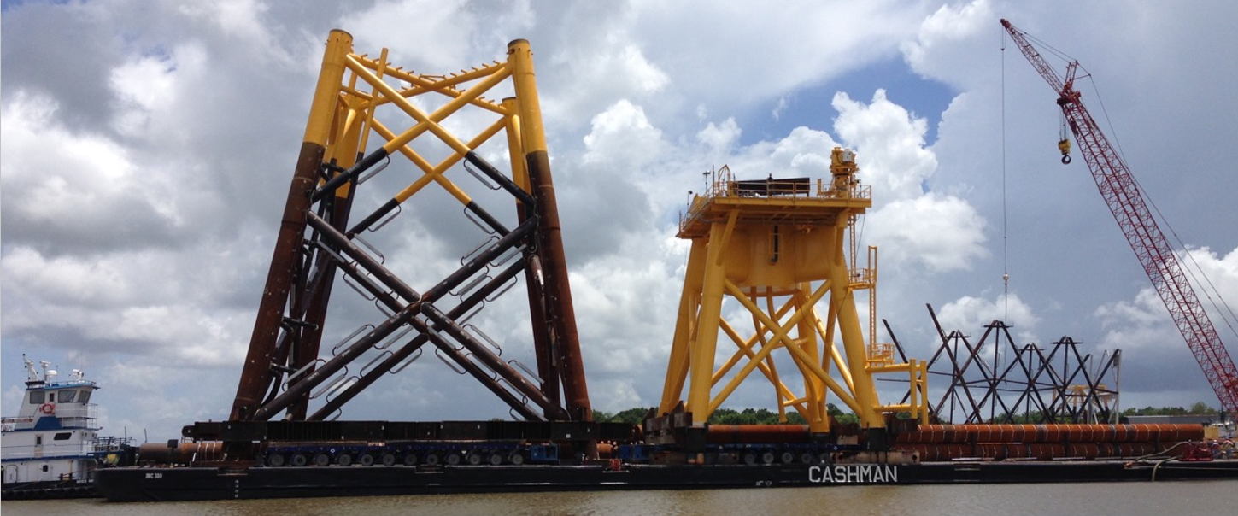
Offshore Wind Value Chain
«2%»
Turbine
inst. ship
only
End customers – «big money»
Huge consolidation among players
Established operators emerging
Track record key
Difficult to play a role if “new”
Contracts: little bi-lateral, mostly tender
Global

Slide 4
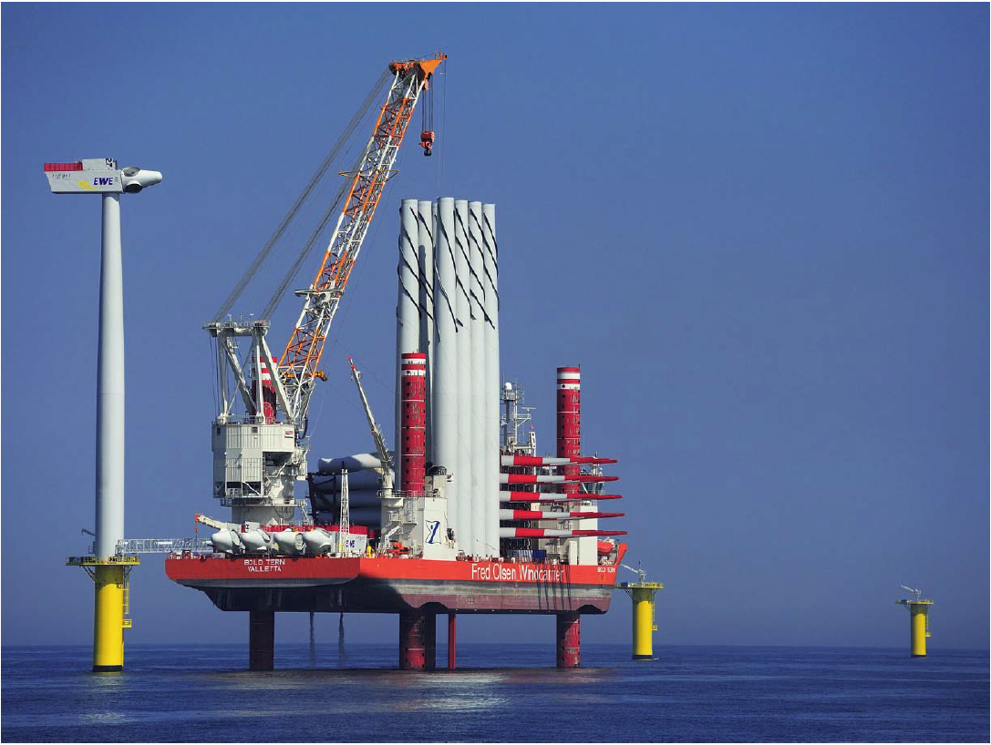
Track record
Riffgat (Germany) - 2013
Bard (Germany) - 2013
2 x Met Mast Dogger Bank (UK)
Alstom (Belgium) - 2014
Global Tech1 (Germany) – 2014/15
Butendiek (Germany) - 2015
Block Island (USA) – (2016)
Veja Matje (Germany) – 2017*
Wikinger (Germany) – 2017*
Borkum Riff. 2 – 2018*
Hohe See – 2019*
Hornsea #1 - 2019
«15%» market share

Slide 5
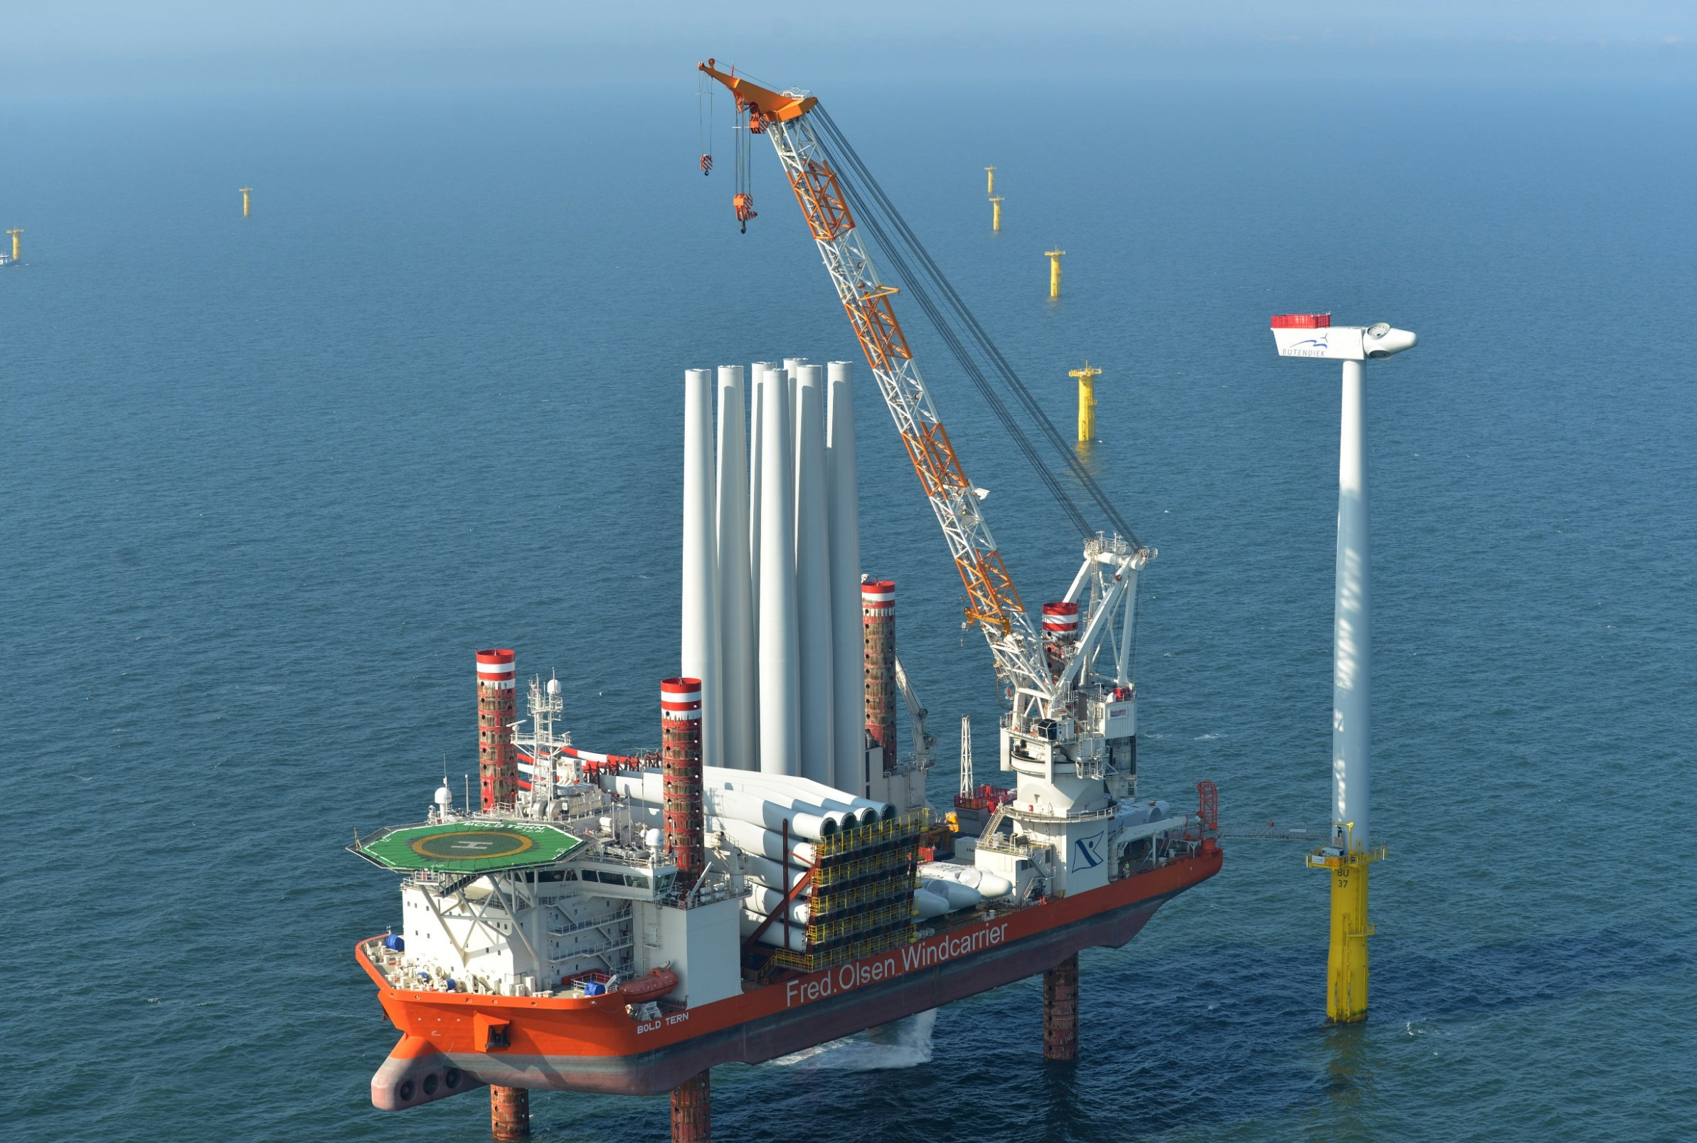
The question is :
How high and heavy
(and «out»)
can you lift ?
Why?

Slide 6
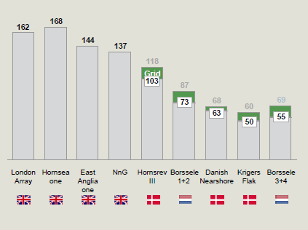
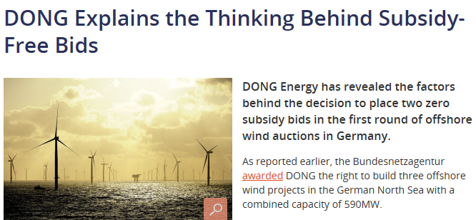
Power Price: A very important picture that will dictate a lot going forward …
2012 – 2015
2016
2017
Euro
13-15MW turbines
85
60
65
65
Current power price wholesale
140£
119£
114£
0
0
0
74.5£
57.5£
57.5£
Gode
Wind
III
Borkum
R West II
OWP
West
HeHe
Dreit
Triton
Knoll
2021
Moray
Firth
2023
Horns
Sea3
2023
2010-2012
ROC’s
2013
FIDER
2015 – first
CfD auction
Auction
Auction
Auction
Auction
Auction
Auction
CfD
Vattenfall
DONG
Vattenfall
Vattenfall
Shell, VanO
DONG
DONG
DONG
EnBW
RWE
EDP/
China
3 G
DONG
20 years – 2% inflation fm 2012
12 years
15 years
12 years
12 years
15 years

Slide 7
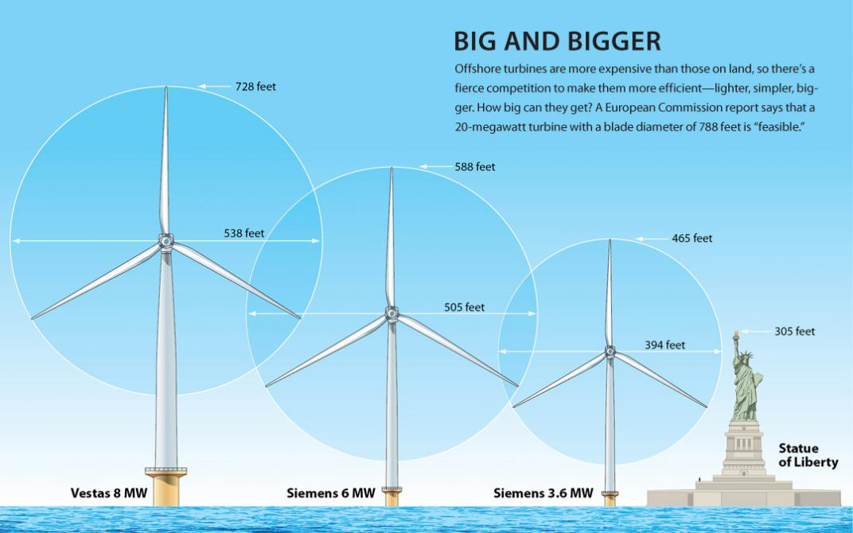
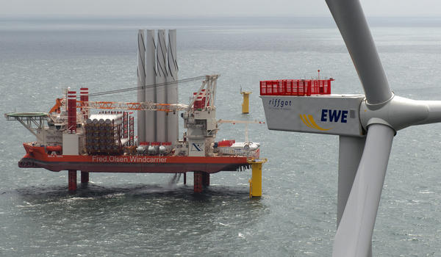
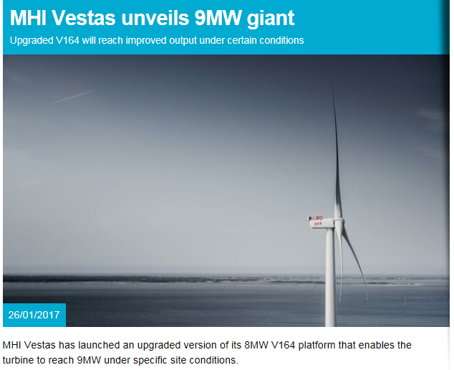
The technology is changing fast …
2017 = 9.5MW
2016
2013
2010

Slide 8
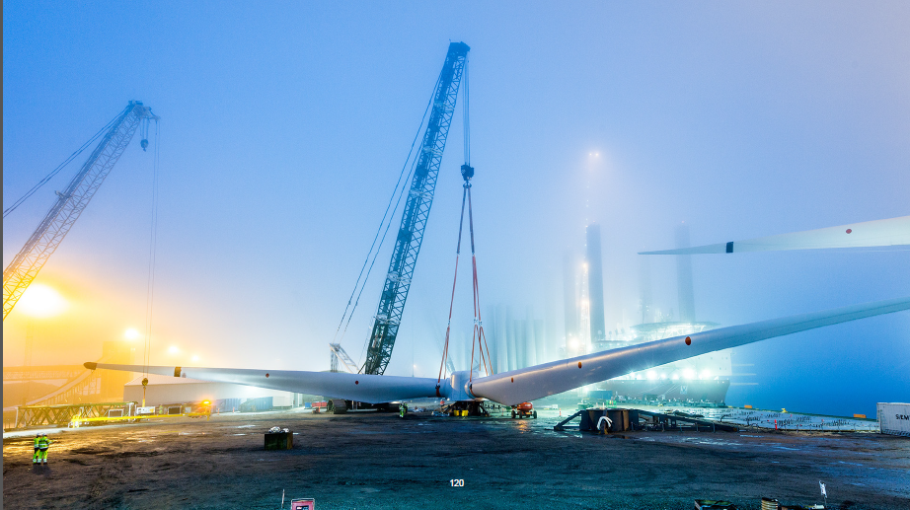
It’s getting really big !

Slide 9
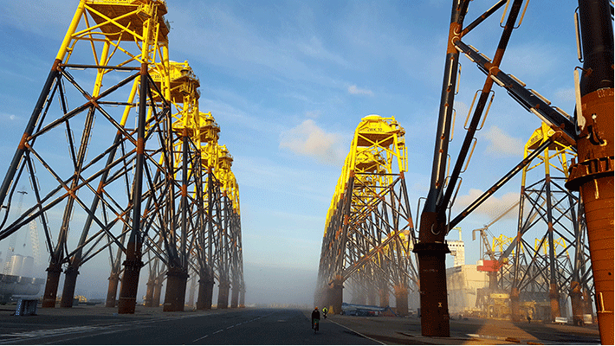
It’s getting really big !

Slide 10
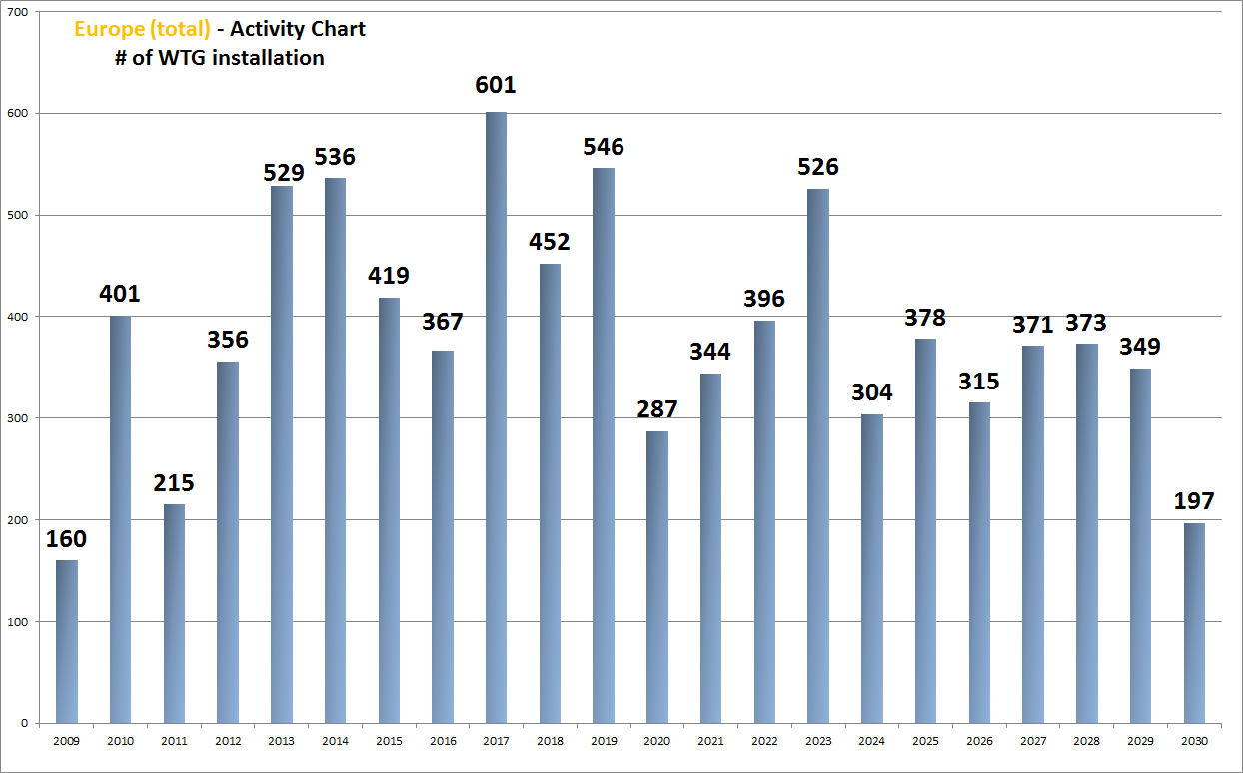
This means that “the market for us” is shrinking ! …
FOWIC contracts
Old regime
All auctions
Assumption:
Peak Holland
France (?)
Poland (or Baltic) starts
Trianel II
Northern
Poland
Rentel
Albat
St.Nazier
10-12-13-15* MW??
8-9.5* MW
Borkum
Riff 2
Hohe See
Le Treport
Poland
Kaikas
Deutche
Bucht
Neth.South#2 + North
FeCamp
Corsuelles
Arkona
?
Poland
Cotre Alb
6-8 MW
East Anglia 1
Seastar
St.Breuix
Neth. South#1
Baltic E
Cherbourg
Clearcamp
5-7 MW
Mermaid
OPW
Atlatis
4.0-6 MW
Merur
Kaskasi
BW2
Trump B
Walney
Ext
Borssele 1&2 3&4
He Dreit
3.3-4.0 MW
Wikinger N/S
Moray F 1
NSee 1&2
HornSea 1
He Dreit
Trump
GW
3
2.3-3.6 MW
Beatice
EA1
HornSea
Inch Cape
Triton Knoll
HornSea 2
East Anglia 1
Horns
Rev III
Vester
havetI
Kriegers Flak
DanT. DK
HornSea
End
-20/21

Slide 11
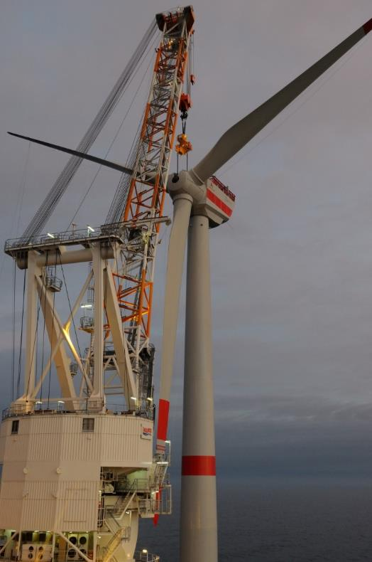
Lifting high and heavy !
120 m
3x40 tons
Turbines that sells in todays market are 8.8-9.5 MW (Siemens and MHI Vestas)
This means heavy lifts
It means high lifts
… and from stable positions, jacked up in > 50 m water
Shore side infrastructure and transport scheduling
450 tons
600 tons

Slide 12
Lifting high and heavy !
120 m
150 m
3x40 tons
60 tons
What if ?
Turbines that sells in todays market are 8.8-9.5 MW (Siemens and MHI Vestas)
This means heavy lifts
It means high lifts
… and from stable positions, jacked up in > 50 m water
Shore side infrastructure and transport scheduling
450 tons
900 tons
600 tons
1100 tons

Slide 13
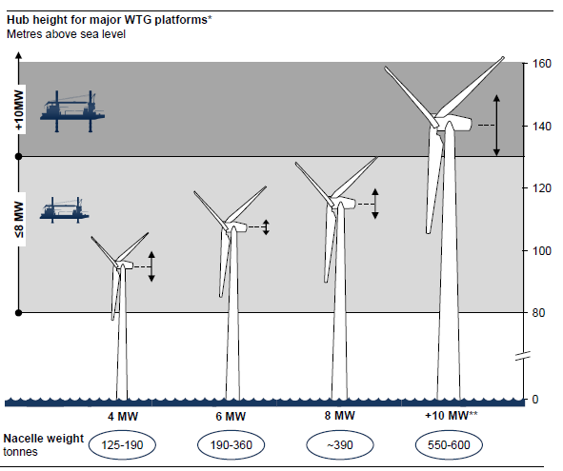
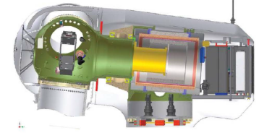
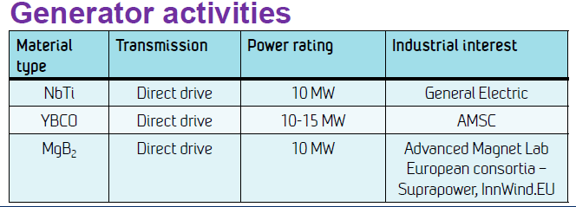
Future challenges and dilemmas …
How high and far out must we lift ? What will happen to the nazelle technology?
Superconductivity
Reduced weight significantly

Slide 14
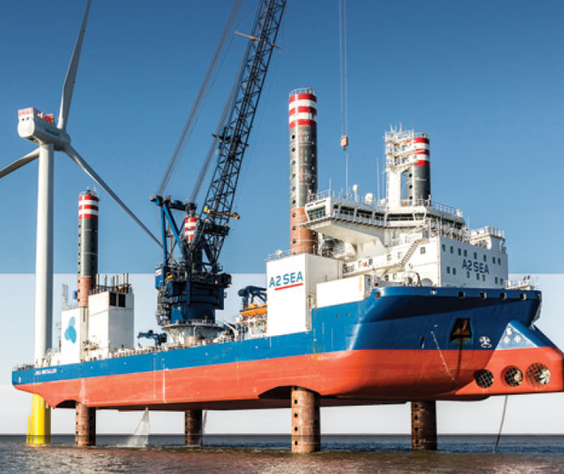
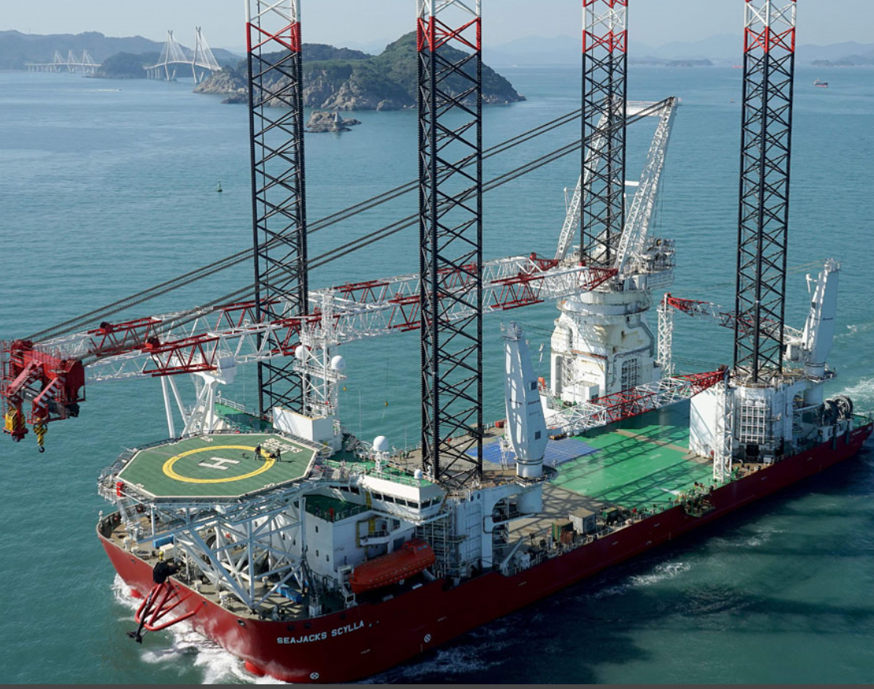
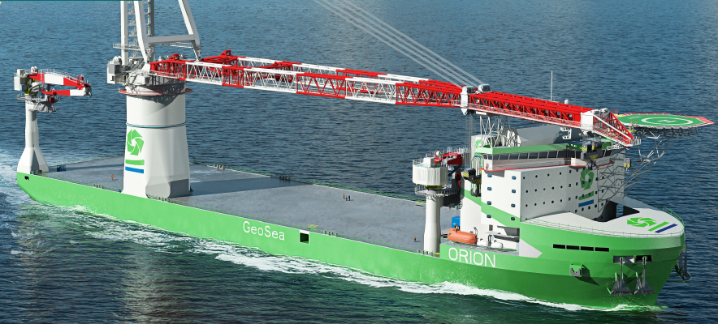
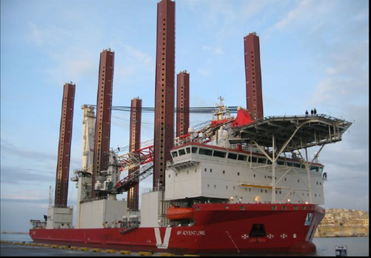
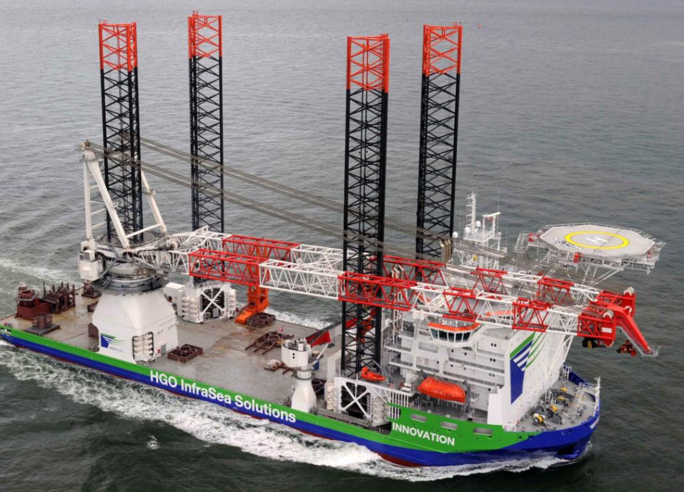
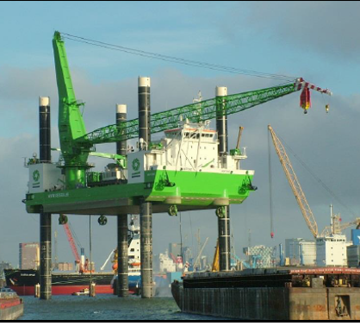
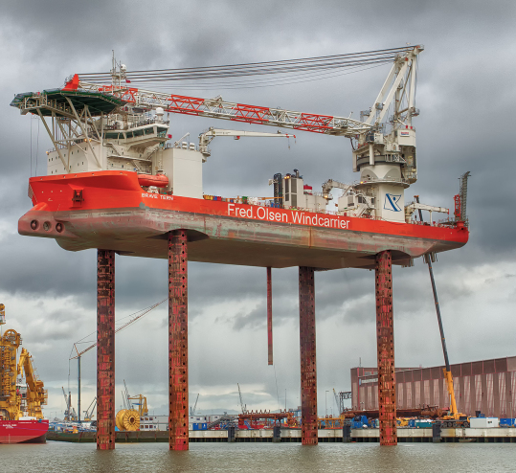
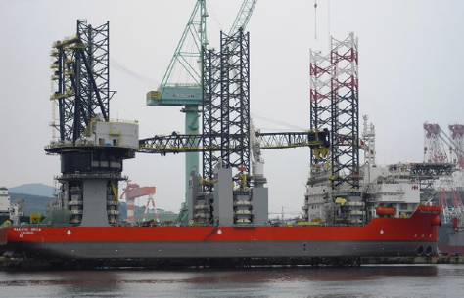
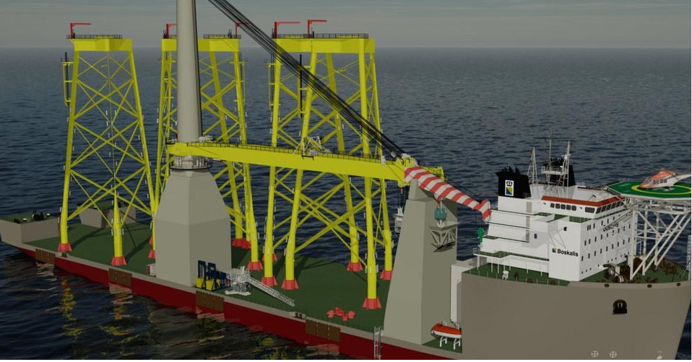
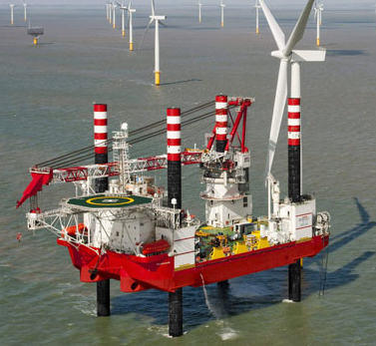
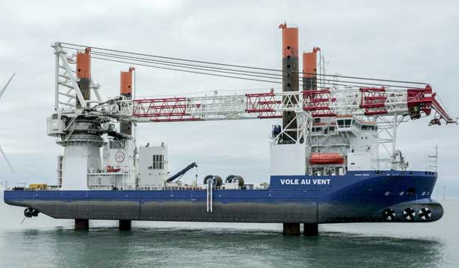
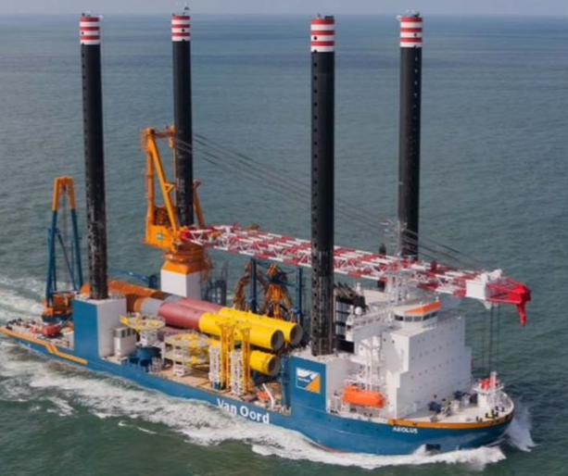
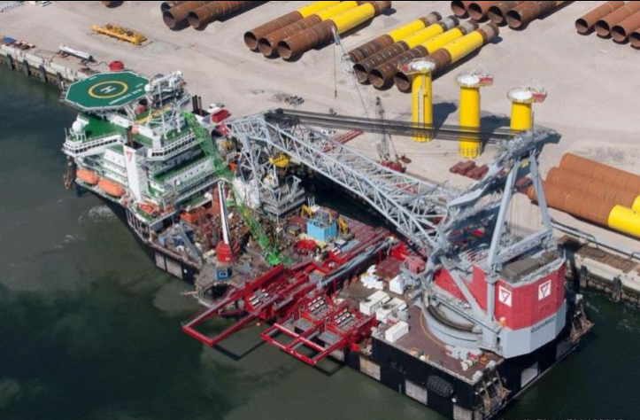
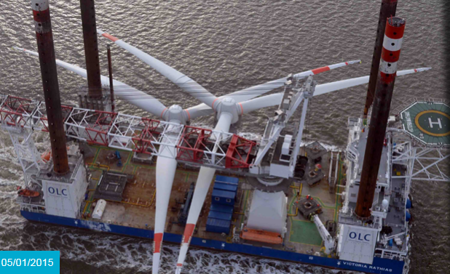
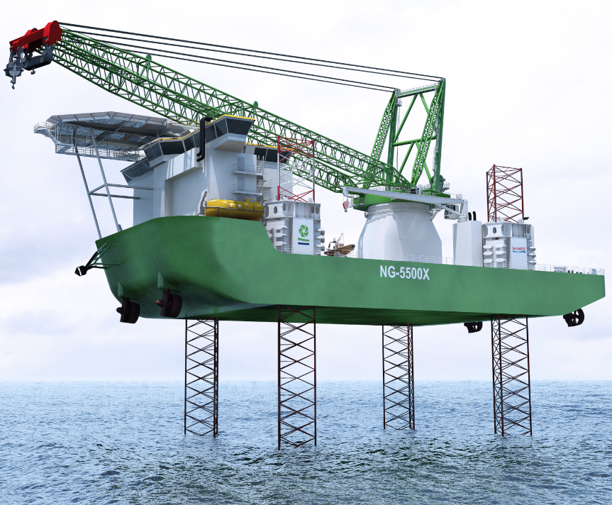
Challenging to keep up with larger turbines
?
A2sea
GeoSea
«Orion»
Scylla
Innovation
FOWIC
Swire
Jan de
Null
Boskalis
«F-class»
Aleous
SHL
Apollo

Slide 15
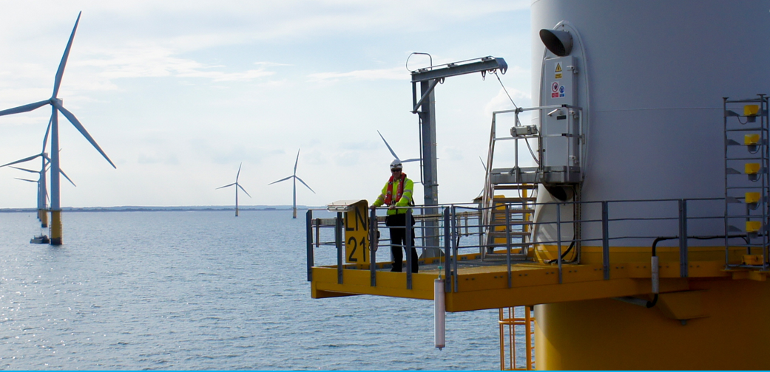
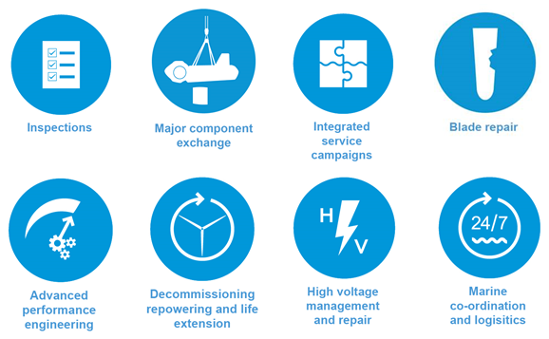
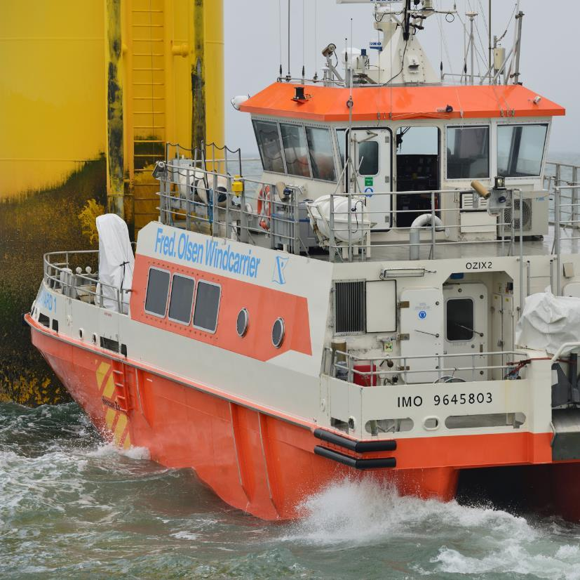
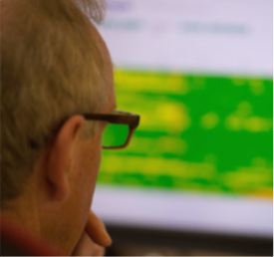
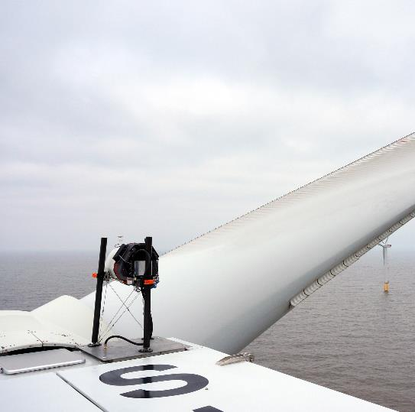
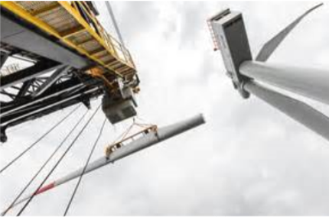
Our O&M service offerings

Slide 16
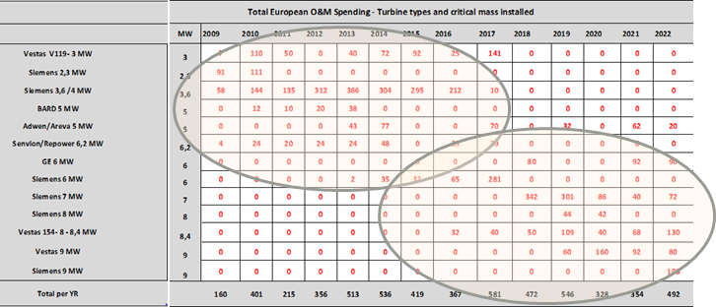
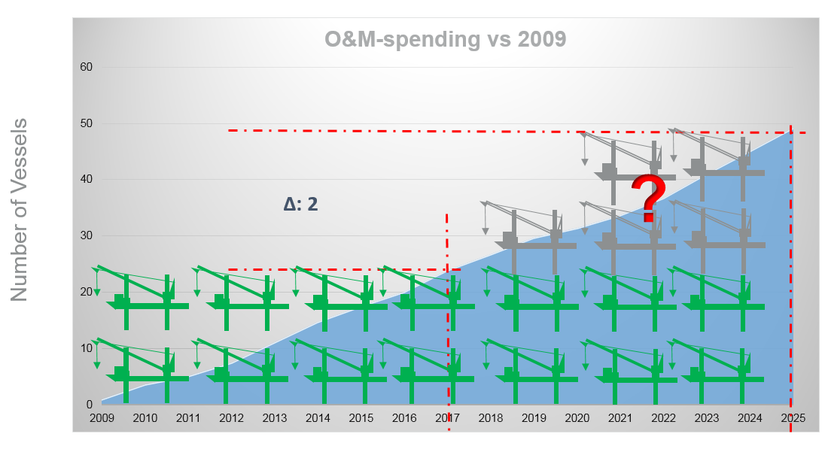
O&M market for main component work is interesting
This implies increasing O&M work … at first with smaller vessels …
… later with larger vessels
Question is how good will the new generation
turbine be?

Slide 17
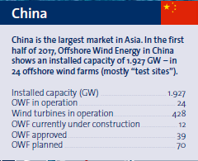
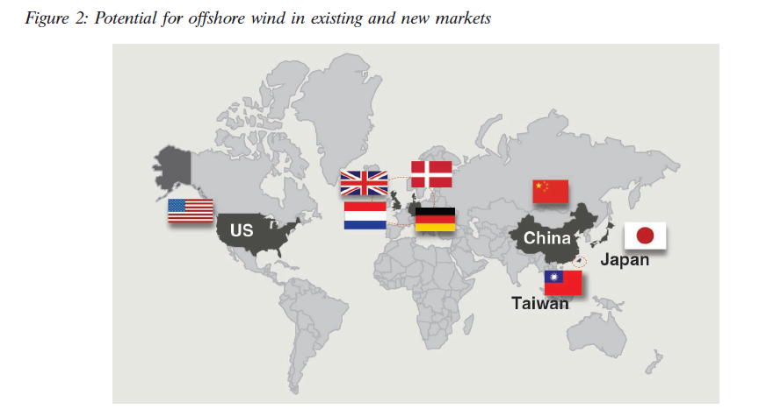
Offshore Wind - a global market in 5 years … ?

Slide 18
On an ending note : Fixed bottom vs. Floating
2008 -
2030 - ?
Why?
Answer: Economics and politics
Fixed bottom is currently leading the cost curve by a wide margin
Consequently, fixed bottom approaching «subsidy free» position (2024/25), will politicians return to paying subsidies for floating unless it is absolutely necessary ? Doubtful.
However, good long term arguments to floating

