Slide 1
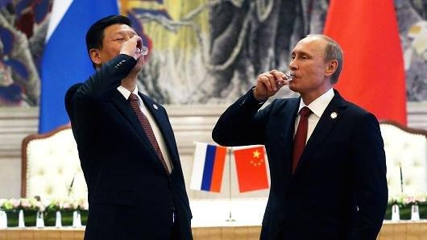
China Trade, Shipping, Foreign Policy and then some
Geir Sviggum
Managing Partner International
Wikborg, Rein & Co.

Slide 2
Take-over in Singapore
The combination of Scandinavian ethics, English law and local competence

Slide 3
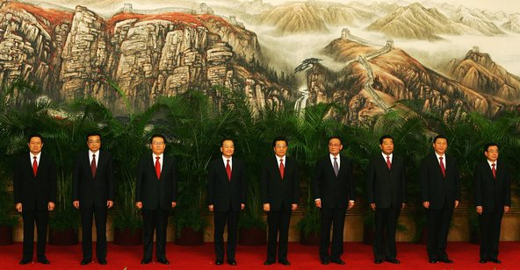
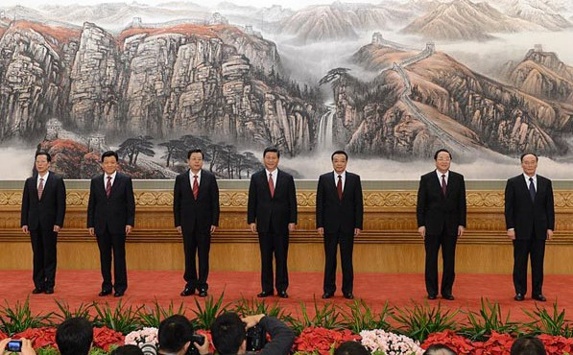

Slide 4
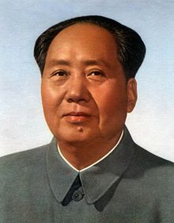

Slide 7
The World is changing fast…

Slide 8
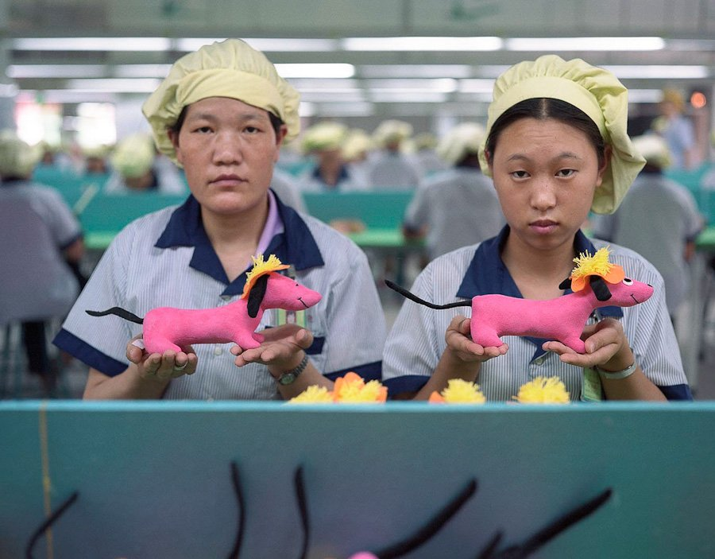
Which version of China do you know?

Slide 9
En hurtig transformasjon verden aldri har sett

Slide 10
The World Bank's Ease of Doing Business Index
Singapore number 1
Norway number 6
USA number 7
Russia number 62
China number 90
Indonesia number 114
Brazil number 120
India number 142

Slide 11
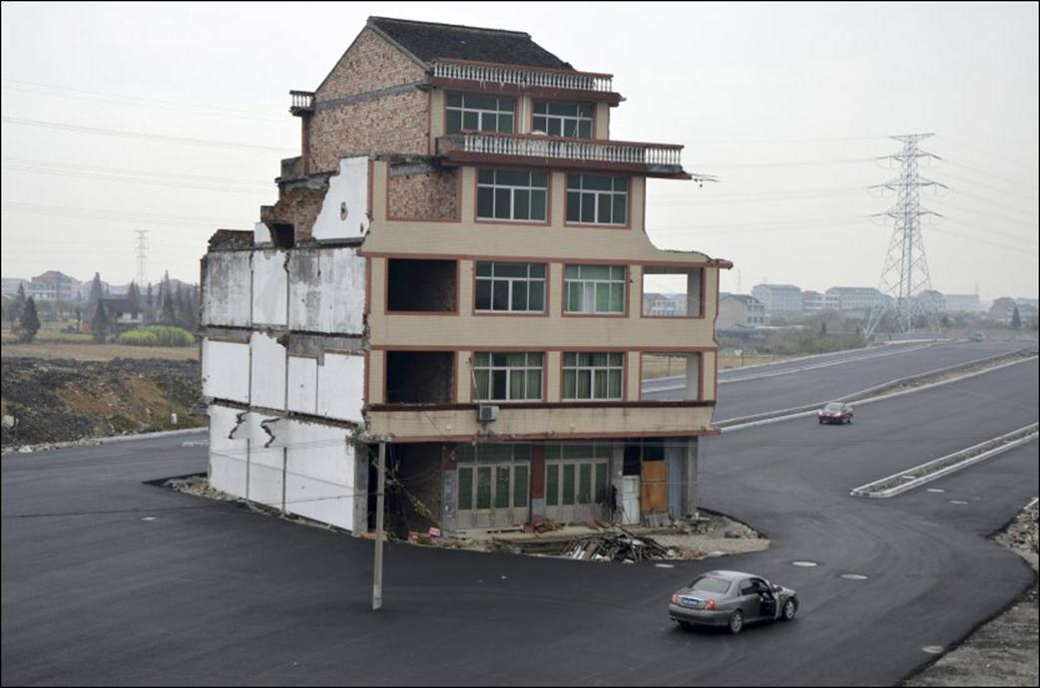
Large structural changes taking place
Especially in the financial sector
This leads to internal struggles for power
A significantly more complex focus than the former one-dimentional growth scenario

Slide 12
Is China facing collapse?
David Shambaugh
"The endgame of communist rule in China has begun, and Xi Jinping's ruthless measures are only bringing the country closer to a breaking point." – Wall Street Journal, 5 March, 2015
Escape! 64% of China's 394 richest has emigrated or are planning to do so
Increased political suppression indicates uncertainty and fear
Shambaugh's subjective experience: even the most loyal cadres are losing faith
Corruption: the problem is too deeply rooted to be successfully handled without political reform
The system as such is blocking necessary economic reform

Slide 13
GavekalDragonomics 27 August 2015
"Such fears are exaggerated; China's economy is not collapsing. But it is slowing – indeed, three of China's provinces are already in recession. And as it continues, the slowdown will inevitably highlight problems that until now have remained largely hidden, triggering fresh bouts of market volatility."

Slide 14
Key sectors going forward
Travel
Healthcare
Technology
Education
Infrastructure

Slide 15
China and the world
China and the US
CNBC-artikkel: "Should America worry about a China-Russia axis? http://www.cnbc.com/id/102106704
China and its neighbours
Alliance partners?
Forgiveness – or lack of such
China and Norway
New common ground?
Opportunities comes spring: technology-driven acquisitions

Slide 16
Shipping
The Yards
The Big Groups merging
A number of collapses
Challenges in obtaining RGs even for larger yards
Offshore focus: poor timing
Charterers (the wave of disputes are coming to an end)
Financing
The Market

Slide 17
- World class lawyers
Chambers and Partners

